Slide 1

The Academy Admissions Process
Ms. Patty Edmond
Deputy Chief, Selections Division
US Air Force Academy
1

Slide 2
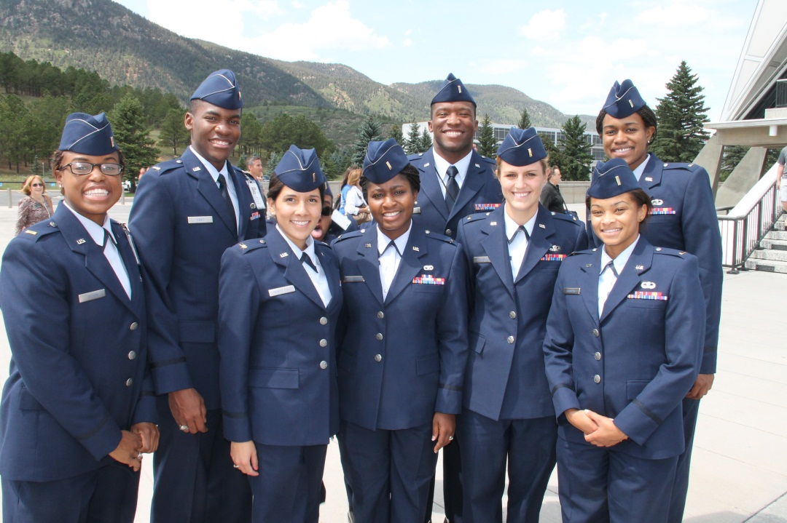
USAFA Mission Statement
  The mission of the United States Air Force Academy is to educate, train, and inspire men and women to become officers of character motivated to lead the United States Air Force in service to our Nation
2

Slide 3
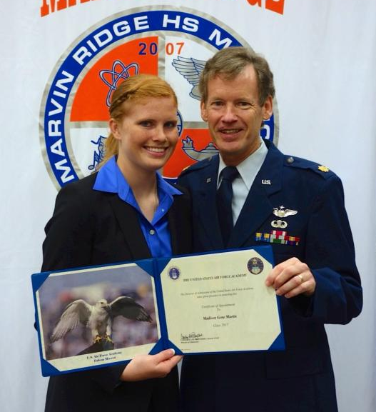
Admissions
Mission Statement
  The mission of the Admissions Office is to seek young men and women who possess the attributes and motivation to successfully complete the Academy experience.
3

Slide 4
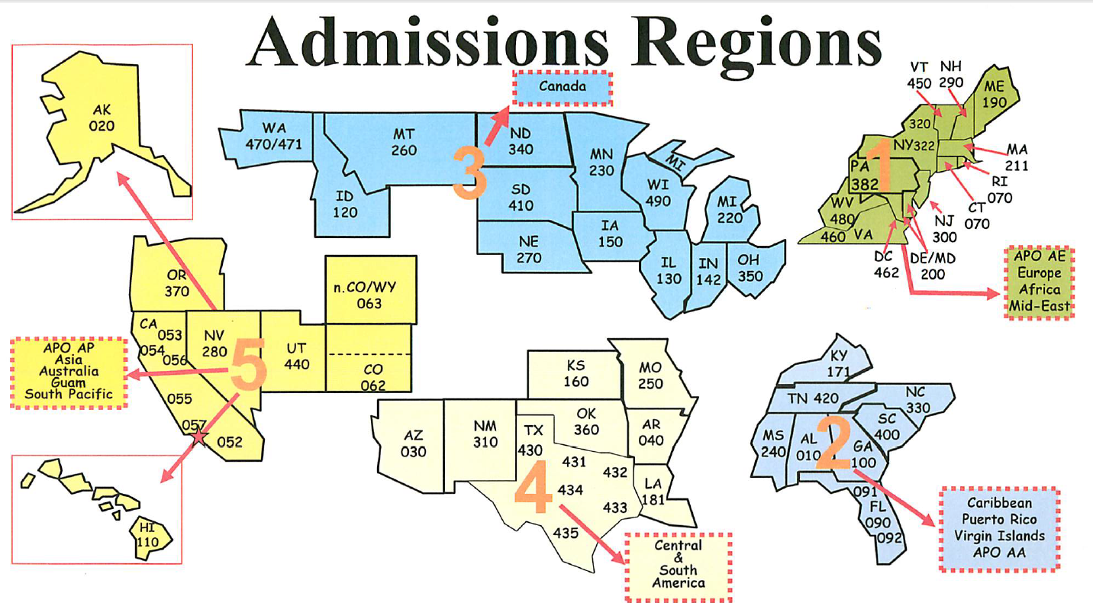
Admissions Regions
  Admissions Regional Teams work tirelessly to meet recruiting, congressional, and support needs within their geographic region.
4

Slide 5
Region 5 Admissions Team
Lt Col (ret) Gay Harrison Regional Director 719-333-7384
Ms. Terri Regan A-K Counselor 719-333-3805
Ms. Bonny Madison L-Z Counselor 719-333-2301
USAFA Tours AcademyAdmissions.com 719-333-2233
5

Slide 6
Basic Eligibility Requirements
U.S. citizen
17 - 22 years of age
  Not passed 23rd birthday as of July 1 of year of entry
Unmarried
  No legal obligation to support a child or other individual
  Not pregnant
Good moral character
6

Slide 7
Basic Qualifications
Academically Successful
Medically Qualified
Physically Qualified
Have Official Nomination(s)
ELIGIBLE FOR AN APPOINTMENT
7

Slide 8
Academic Preparation
High School Curriculum
High school college preparatory curriculum
  4 years of math
    Algebra I and II, geometry, trigonometry, pre-calculus
  4 years of science with lab
    Chemistry, biology, physics, other
  4 years of English
    Candidates must be able to write and speak well and have a foundation in literature
  3 years of history and social sciences
    U.S. history, government/civics, economics, etc.
  2 years of a modern foreign language
8

Slide 9
Academic Preparation
High School Curriculum
Admissions will evaluate your transcript and recalculate your GPA
  Additional weight for Advanced Placement, International Baccalaureate, and Dual Credit
  Additional weight for Honors courses, but less than above
Non-academic courses are not calculated in your GPA
The recalculated GPA and your test scores will be combined for an overall academic composite
9

Slide 10
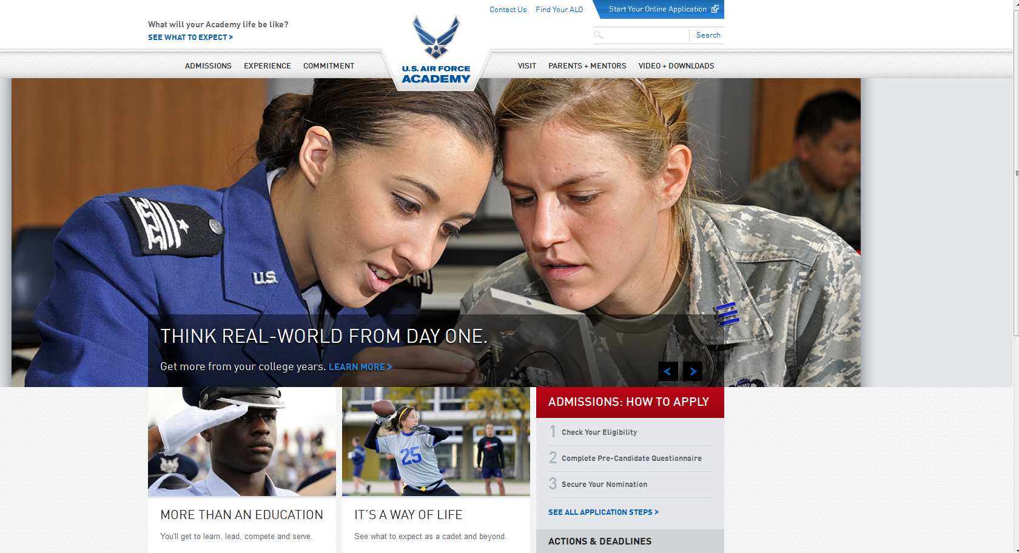
www.academyadmissions.com
Link to admissions portal

Slide 11
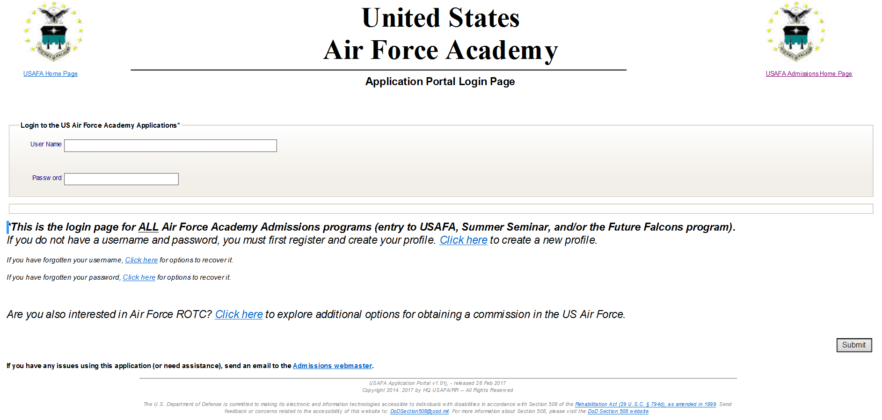

Slide 12
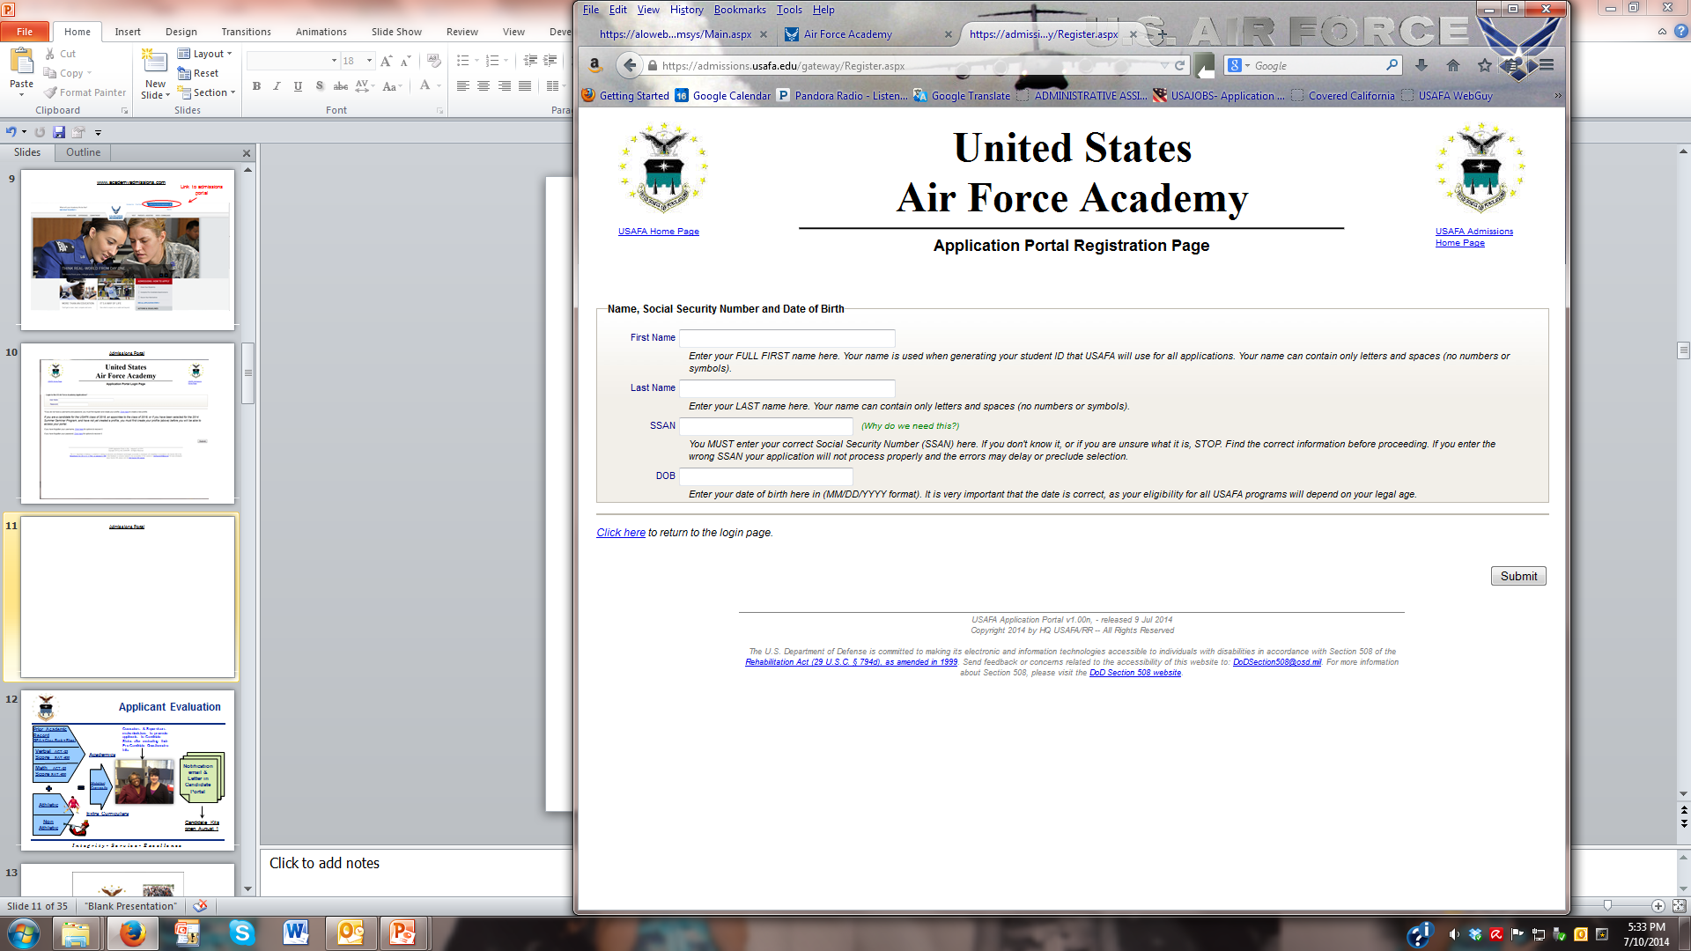

Slide 13

Instructions to Applicants
Candidate & Parents Should Read!
Mar 2017

Slide 14
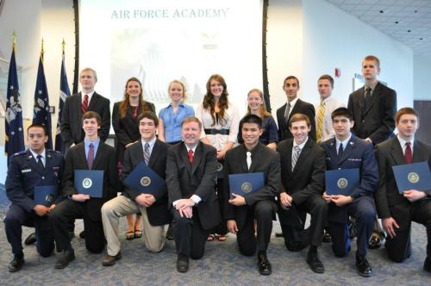
Nominations
Congressional
Representative
Both U.S. Senators
Vice President
Military Related
Presidential (unlimited but only100
appointments)
Honor Military Schools / AFJROTC
Deceased / Disabled / MIA (65)
Medal of Honor (unlimited)
A nomination is required to receive an appointment, but receiving a nomination does not guarantee an appointment.
Notes:
Deadlines usually in October
Interviews usually around Thanksgiving
Nominations due to Admissions by January

Slide 15
Nominations
Apply to every nominating source
Consult congressional websites for procedures and deadlines (www.senate.gov and www.house.gov)
Separate nomination for each service academy
Deadlines usually in October
  Interviews usually around Thanksgiving
  Nominations due to Admissions by January
Notes:
Securing a nomination
Apply to all nominating sources
Everyone can apply for:
Congressional
District of your parents’ home of record
Deadlines and procedures differ
Consult the Congressperson’s website
Usually require an interview
Interviews generally occur around Thanksgiving
May require essays/resume, etc
Deadline for Congressperson to submit nomination is 31 Jan 2010
Senatorial
Your parents’ home state
See above
Apply to the Vice President
Deadline is 31 Oct 2009
Other nominating categories
Presidential
Son/daughter of Active duty military
On active duty at least 8 years
Retired
Son/daughter of Reservist
Unlimited nominations, but only 100 appointments
JROTC honor unit
Unlimited nominations
Only 20 Appointments (also competes with ROTC)
The nomination process is independent of the USAFA Admissions process

Slide 16
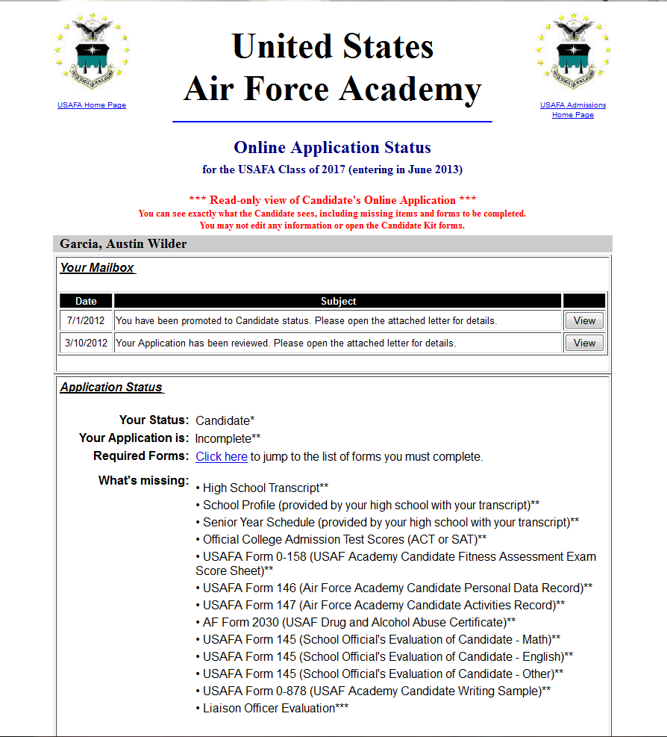
By Mid-July 2017

Slide 17
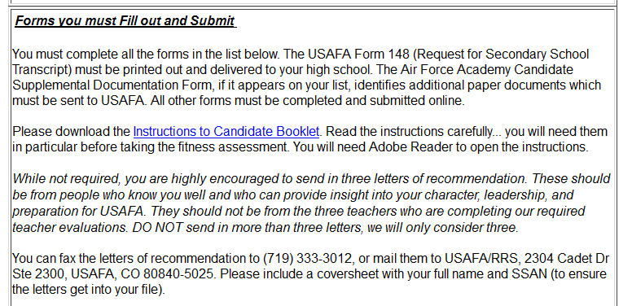
Candidate & Parents Should Read!

Slide 18

Instructions to Applicants
July 2017

Slide 19
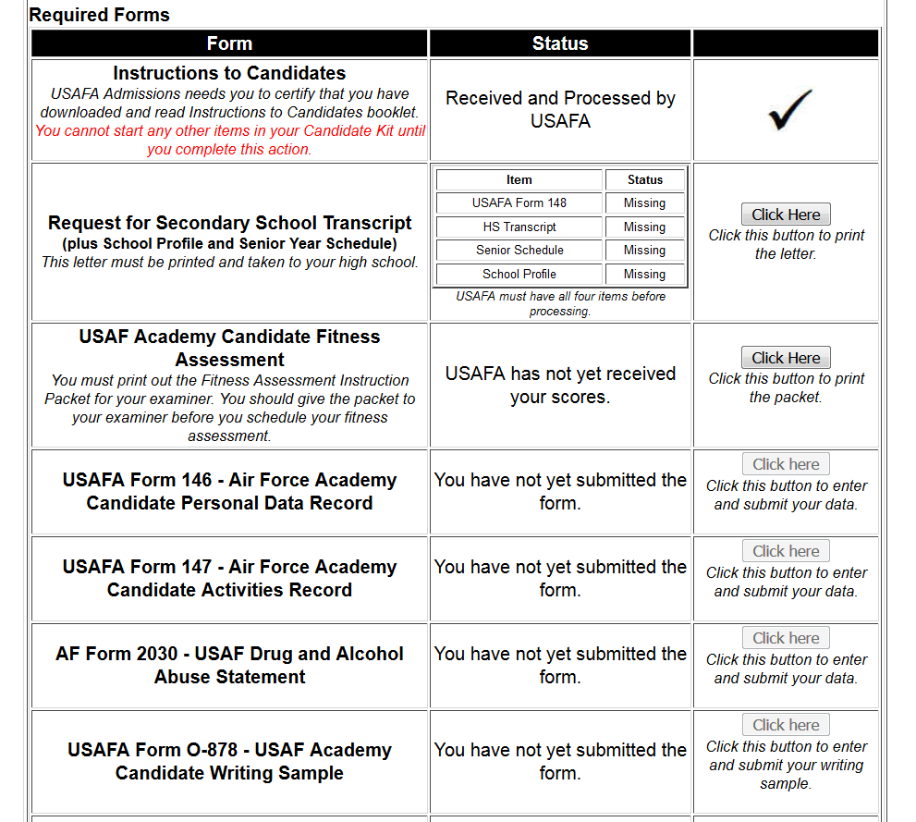
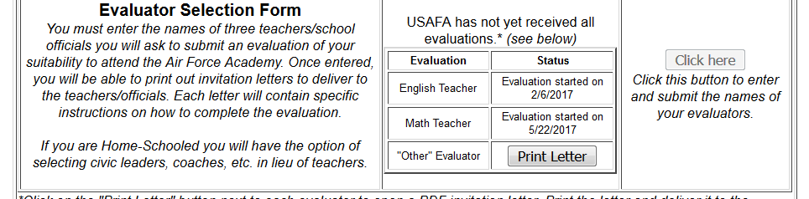
Candidates must complete three items before we will schedule them for a DoDMERB physical

Slide 20

Medical Qualification
Medical examination coordinated by the Department of Defense Medical Evaluation Review Board (DoDMERB)
  Must complete the majority of your candidate kit before your name is sent to DoDMERB
  DoDMERB will notify you to schedule your examination
  Results sent to Admissions: Meets Standards/Does Not Meet Standards
  Waivers (We will request if competitive)
  COMPLETE YOUR EXAM AS SOON AS POSSIBLE!!

Slide 21

Applicant Evaluation
Prior Academic
Record
(GPA + Class Rank + Rigor)
Counselors & Supervisors make decisions to promote applicants to Candidate Status after evaluating their Pre-Candidate Questionnaire info.
Verbal ACT >23
Score SAT >530
Academics
Math ACT >23
Score SAT >530
Notification email & Letter in Candidate Portal
Weighted
Composite
Athletic
Extra Curriculars
Non
Athletic
Candidate Kits open 15 July

Slide 22
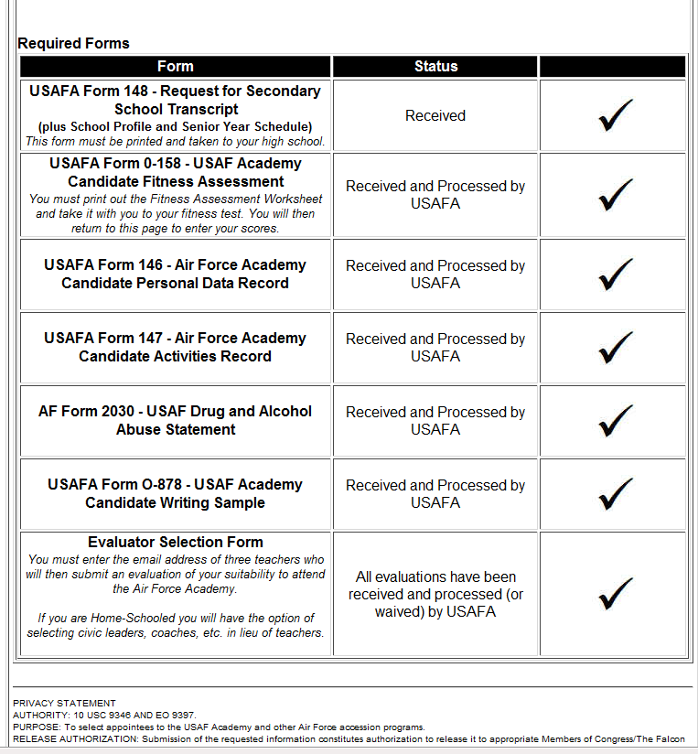
Rolling Deadline
Once an application is promoted to Candidate Status – 4 months to complete the application
Deadlines will be between
  1 November and 31 January

Slide 23

Teacher Evaluations &
Letters of Recommendation
Three required teacher evaluations
  Math
  English
  Other (Science or High School Counselor preferred)
  What type of student are you?
Two optional letters of recommendation
  Not from family
  Not from teachers that already did evaluations
  What type of person are you?
Notes:
Teacher evaluations – also looking at character, integrity, examples of leadership in the classroom, etc.
LOR – character, integrity, leadership, ethics - examples
Tell the selection panel something that is not already known through your transcript and resume. The writer should know you well.

Slide 24
The Goal

Slide 25
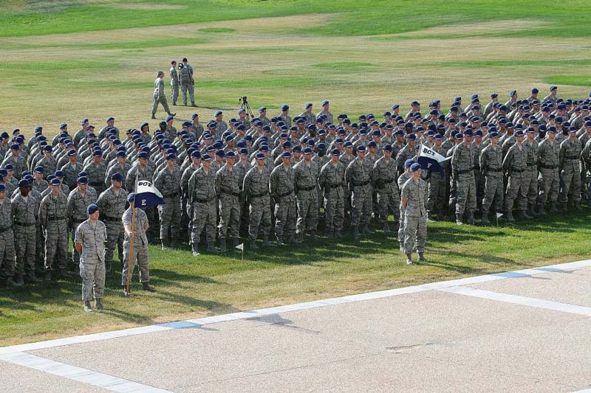
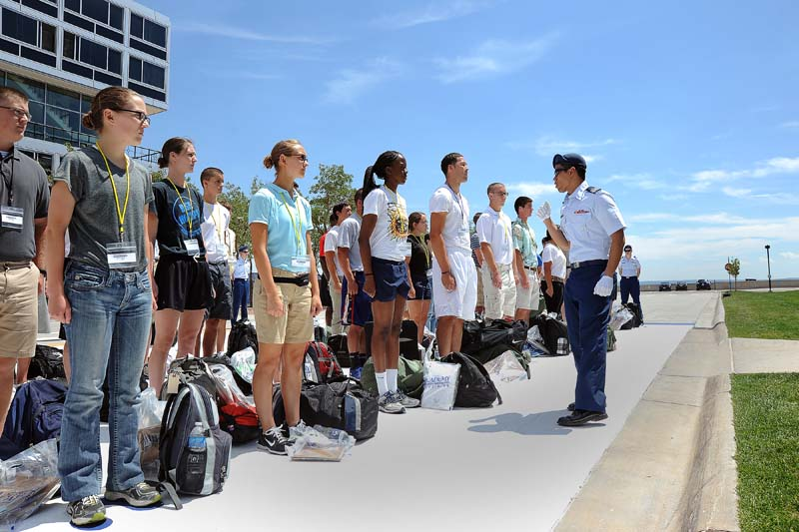
Selections
How We Compose
a Class

Slide 26
Admissions Measures
50%
20%
30%
Extracurricular Activities
Selection Committee Holistic Review
Academics
Physically Qualified (CFA)
Medically Qualified (DoDMERB)
Nomination
Notes:
It benefits you to complete your application early. Why? We do some early offers in the fall! If you are highly qualified and we are very interested, we may offer you an early appointment and let your nominating sources know we are interested which may encourage them to give you a nomination.
Selections panel takes a “whole person” look at your application and provides a qualitative rating.

Slide 27
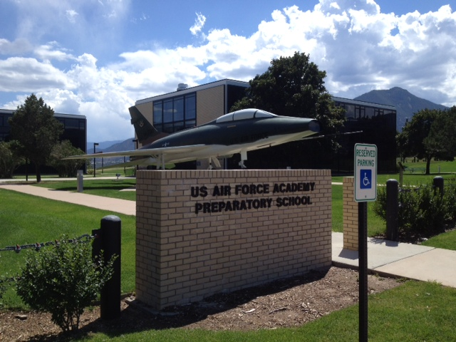

Prep/Falcon Opportunities
Candidates not selected for a direct appointment, and possibly with a need for additional academic preparation, may still be considered for the USAFA Preparatory School or a Falcon Foundation Scholarship
  Must be medically and physically qualified
  Nomination not required for entry
  All candidates are automatically considered for prep
  Successful completion may guarantee entry the following year

Slide 28
What are the odds?
Inquiries—13,567
Summer Seminar
Applicants—9894
PCQ
Candidate Pool—7,789
Candidate Kit
Preparatory School
(273 offered - 241 entries)
Falcon Scholars
(119 offered - 60 accepted)
Panel Rated Files~3,400
Completed Admission File
Qualified Candidates—2,475
Academy Board
+
Nominations
+
Medical
Offers—1492
Admitted Cadets 1,152
+
International Cadets 16
+
1,168 Entries to Class of 2020
14% USAFA Prep
6% Falcon
65% Direct Entry

Slide 29
Timeline
1 March – Applications for 2022 Opened
1 July – Re-Applicants may apply
Mid July – Candidate Kits Open. Individual Deadlines Set
31 December – Final deadline to apply for Class of 2022
31 January – Final deadline to complete file
Feb – March – Regular Selections
March – Most Appointment Notifications
April – Non-Select Notifications
April – Prep/Falcon Appointment Notifications
May – Deadline to accept direct appointments
June – USAFA in-processing
July– USAFA Prep School begins

Slide 30

Questions and Answers

Slide 31

31

Slide 32
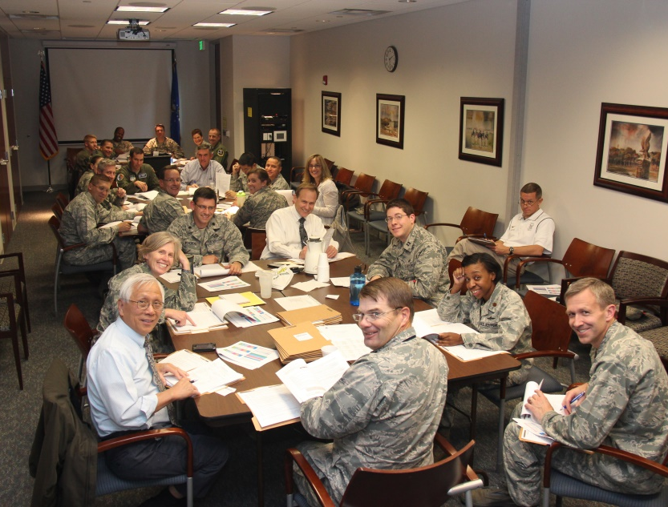
Holistic Review
What is it?
  A look at the entire record to piece the parts together
  Understanding if the candidate has the characteristics to develop into an officer of character
  Taking an educated guess on the likelihood that a candidate can complete one of the Academy’s programs
Evaluation Factors
  Academic Achievement, Quality, and Potential
  Physical Qualifications
  Personal Characteristics and Attributes
  Leadership & Character
Notes:
Where do the DACs fit in?

Slide 33

Academic Composite
Prior Academic
Record
(GPA + Class Rank + Rigor)
Admissions will evaluate the transcript and recalculate the GPA
  Additional weight for Advanced Placement, International Baccalaureate, and Dual Credit
  Additional weight for Honors courses, but less than above
Non-academic courses are not calculated in GPA
The recalculated GPA and SAT/ACT test scores will be combined for an overall academic composite
Verbal ACT>23
EBRW SAT>530
Math ACT>23
Math SAT>530
Levels
Academic Record = Top 20%
EBRW/Reading = 600-680 SAT or 27-32 ACT
Math/Sci Reasoning = 630-700 SAT or 28-33 ACT

Slide 34


Academic Preparation Standardized Tests
Take tests early and often
We accept the highest score from each category (super score)
Have official scores sent directly to USAFA NLT Jan 31
The New SAT will be evaluated separately from the previous SAT
Notes:
We do not mix and match ACT and SAT scores.

Slide 35

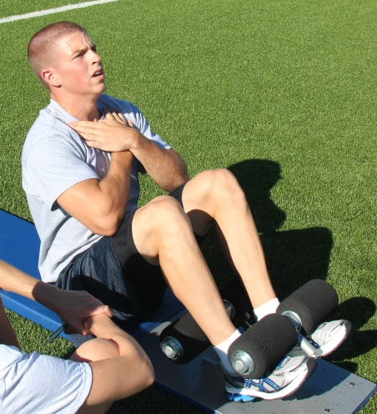

Physically Qualified
Candidate Fitness Assessment (CFA)
  Six events done in succession
    Basketball throw
    Pull-ups*
    Shuttle Run
    Sit-ups
    Push-ups
    Mile run
Automatic re-test authorized for 1st failure.
DQ for 2nd failure to meet CFA standards
PRACTICE
PRACTICE
PRACTICE
Practice
Practice
Practice

Slide 36
Competitive Levels For Direct Entry
Academic Record = Top 20%
English/Reading = 600-680 SAT or 27-32 ACT
Math/Sci Reasoning = 630-700 SAT or 28-33 ACT
Scores achieved under non-standard conditions are not accepted.
________ Max Avg(2014) ___
Candidate Fitness Assessment Male Female Male Female
Basketball Throw 102’ 66’ 69’ 42’
Pull-ups 18 7 12 2
Flexed Arm Hang (Females) (Seconds) 63 31
Shuttle Run (4x10 yd) (Seconds) 7.8 8.6 8.1 9.4
Crunches 95 95 81 78
Push-ups 75 50 62 41
One-mile Run 5:20 6:00 6:29 7:30

Slide 37



Extra Curricular
  Demonstrated character and leadership
  Demonstrated physical ability
  Good balance of athletic and non-athletic activities
Counselors & Supervisors make decisions to promote on a case by case basis for scores below these.
Athletic
Extra Curricular
Composite
Non
Athletic

