Slide 1
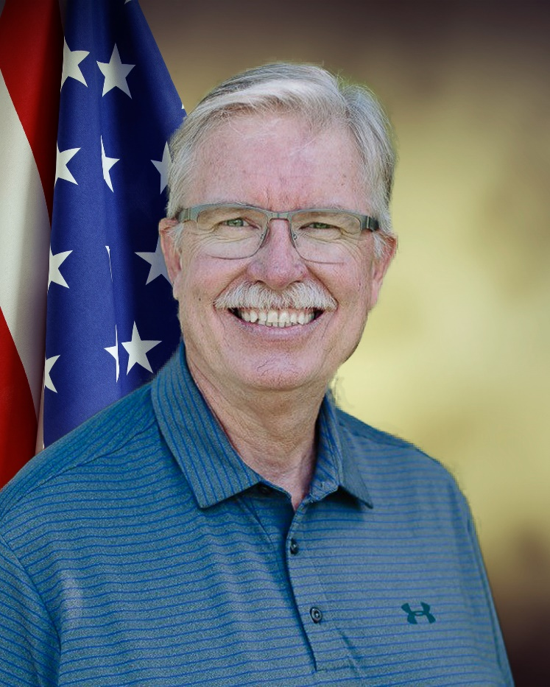
USAF 1969-1973 Former Marriage & Family Therapist USAFA Parents Assn of LA, Past President 2009 Retired/Civilian ALO of the Nation Admissions Officer, USAFA
Mr. Bill Preston
Director, Parent & Chapter Programs
USAFA Assn of Graduates

Slide 2
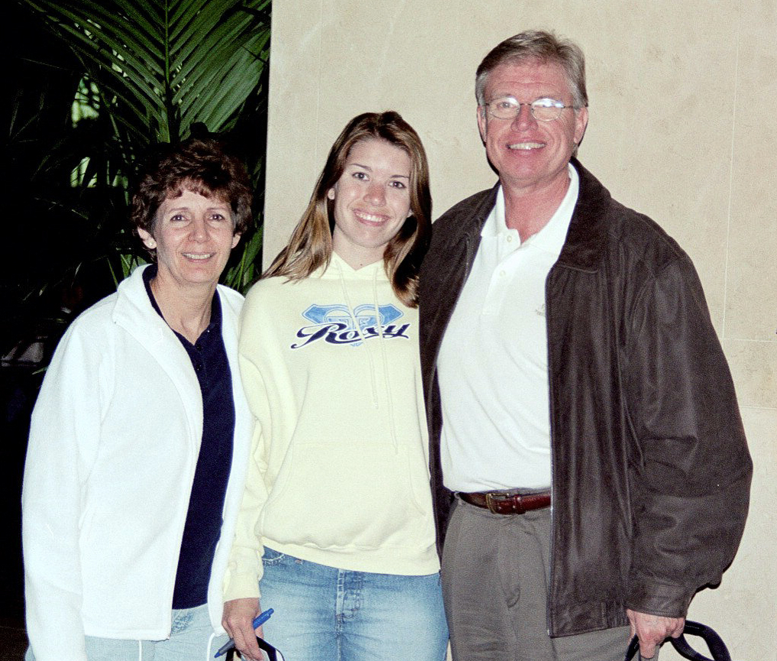
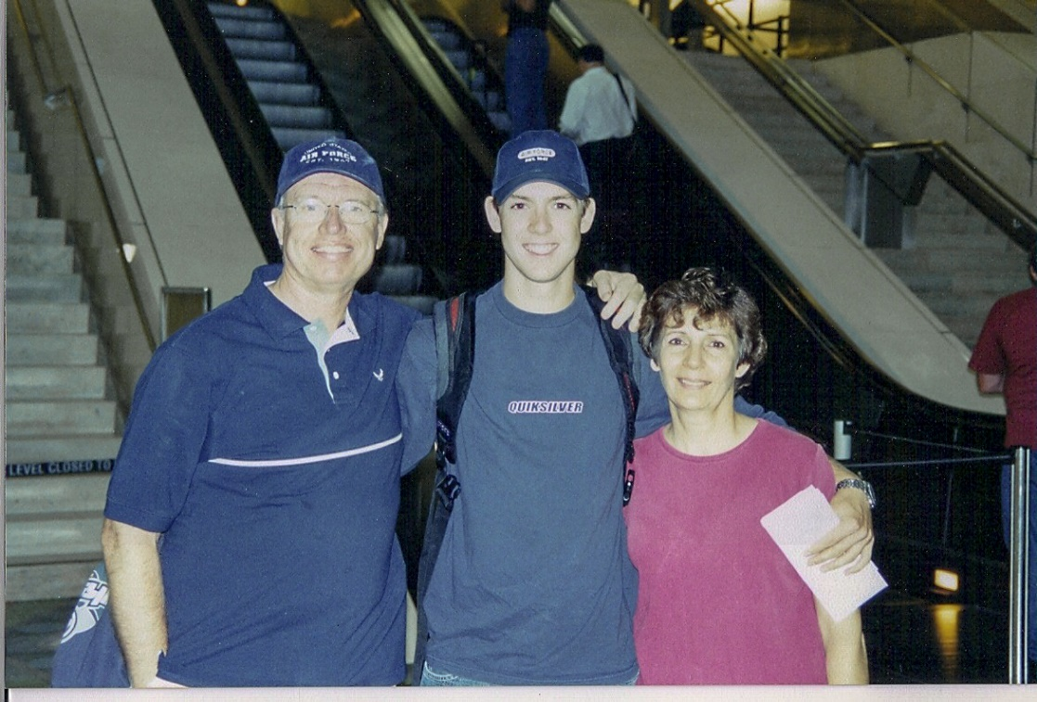
Lessons Learned as an Air Force Parent
February 2003
July 2003

Slide 3
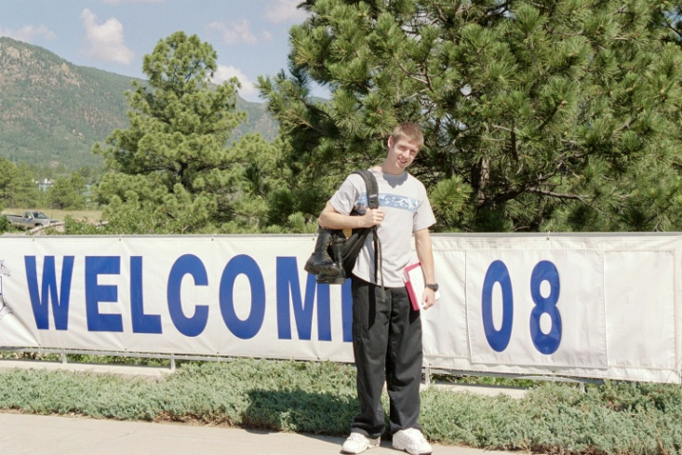
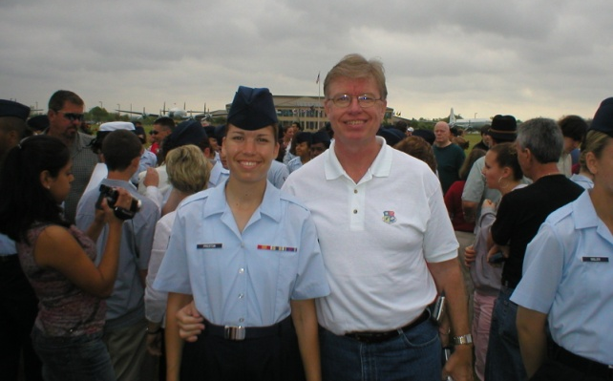
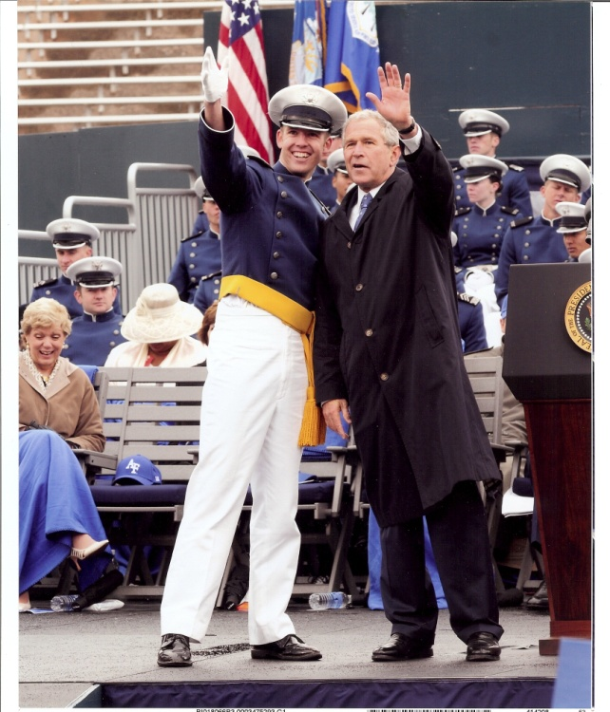
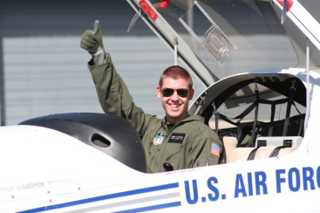
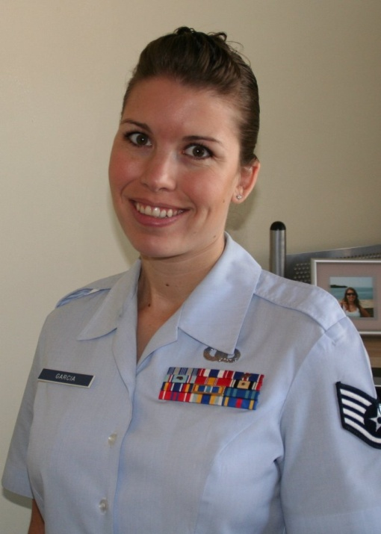
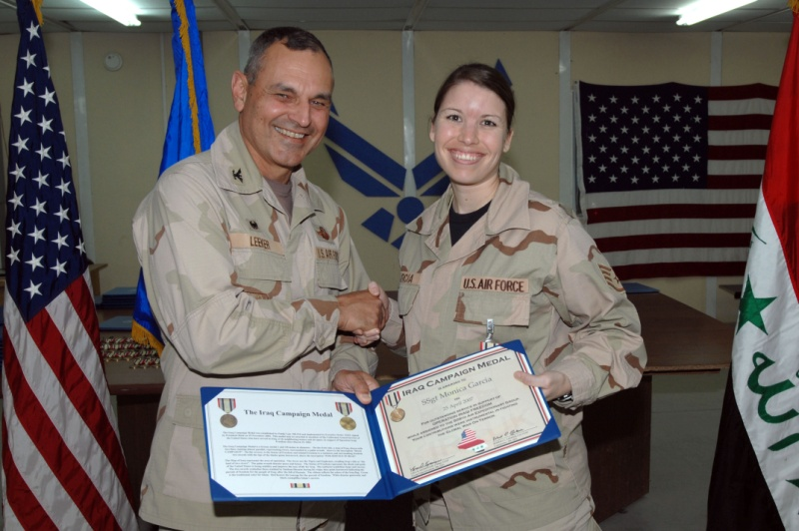
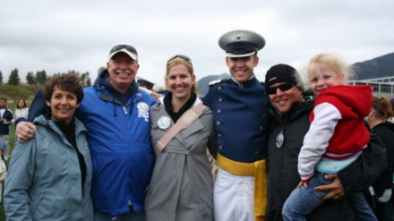

Slide 4
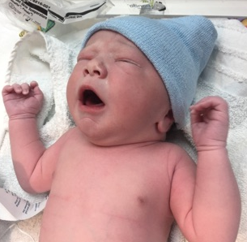
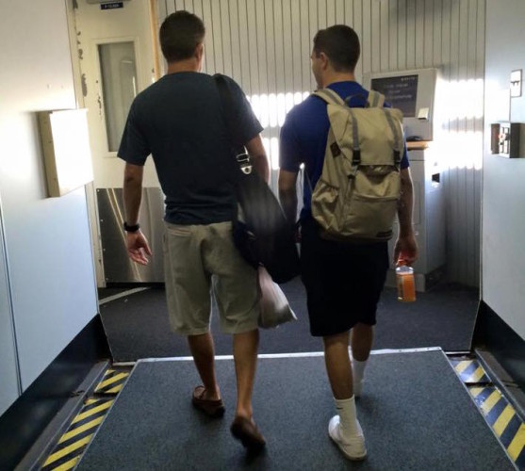
Life Is a Process!
Remember this process began long ago
The continuum began when our children needed everything from us, and now they should need far less as they further develop independence. It’s our job as parents to support that.
It’s always easier for some to navigate than for others.
Notes:
You may have noticed that your children different than you.
Some of that is just because they’re young, but every generation has its own unique characteristics
The more we know about this next generation – how they perceive things and what’s important to them – the better we all as parents can do to launch them successfully.
We are going to walk you through some generational differences , talk about why and how the Millennials (as we call them) are different and finish up with some specific tips for helping your Millennial children get ready to prepare for a service academy education.

Slide 5
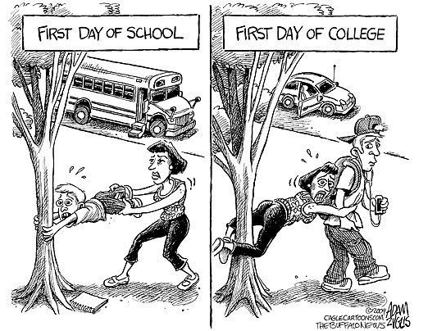
This is a time of transition in your roles with your children
Notes:
You may have noticed that your children different than you.
Some of that is just because they’re young, but every generation has its own unique characteristics
The more we know about this next generation – how they perceive things and what’s important to them – the better we all as parents can do to launch them successfully.
We are going to walk you through some generational differences , talk about why and how the Millennials (as we call them) are different and finish up with some specific tips for helping your Millennial children get ready to prepare for a service academy education.

Slide 6
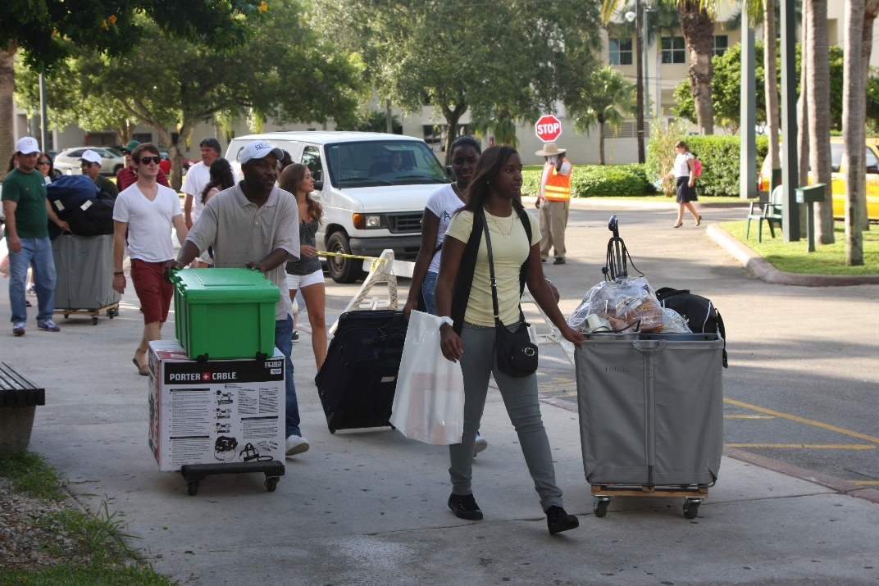
For some it will look like this…
Notes:
You may have noticed that your children different than you.
Some of that is just because they’re young, but every generation has its own unique characteristics
The more we know about this next generation – how they perceive things and what’s important to them – the better we all as parents can do to launch them successfully.
We are going to walk you through some generational differences , talk about why and how the Millennials (as we call them) are different and finish up with some specific tips for helping your Millennial children get ready to prepare for a service academy education.

Slide 7
For some it will look like this… <video of inprocessing and BCT>
Notes:
You may have noticed that your children different than you.
Some of that is just because they’re young, but every generation has its own unique characteristics
The more we know about this next generation – how they perceive things and what’s important to them – the better we all as parents can do to launch them successfully.
We are going to walk you through some generational differences , talk about why and how the Millennials (as we call them) are different and finish up with some specific tips for helping your Millennial children get ready to prepare for a service academy education.

Slide 8
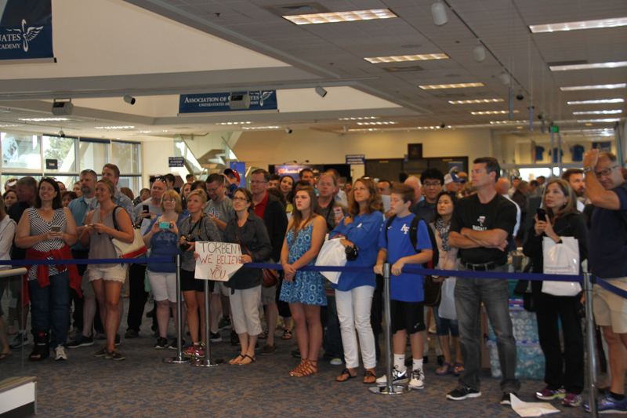
Your parental role is going to suddenly change
Active Participation
Passive Support
Notes:
“Raised as parent’s friends” – One of my recent candidates volunteered that, “My parents and I put this resume together.” I was surprised on two accounts: 1) his parents helped him, 2) he told me (didn’t think twice about his parents helping him with his resume)
“Parents remind them” – I read an article in the Wall St Journal were a Millennial missed an important deadline at work. When his manager asked him why he missed the deadline, he said, “Why didn’t you remind me?”
- Remember this point as we talk about how much hand holding we should do with our candidates
“Well looked after” – Not only from the entitlement perspective (earlier slide), but also just watched more closely. How many of you heard, “Go outside and play … come back when the street lights come on?” This never happens with kids today. Plus, they all are connected through cell phones

Slide 10
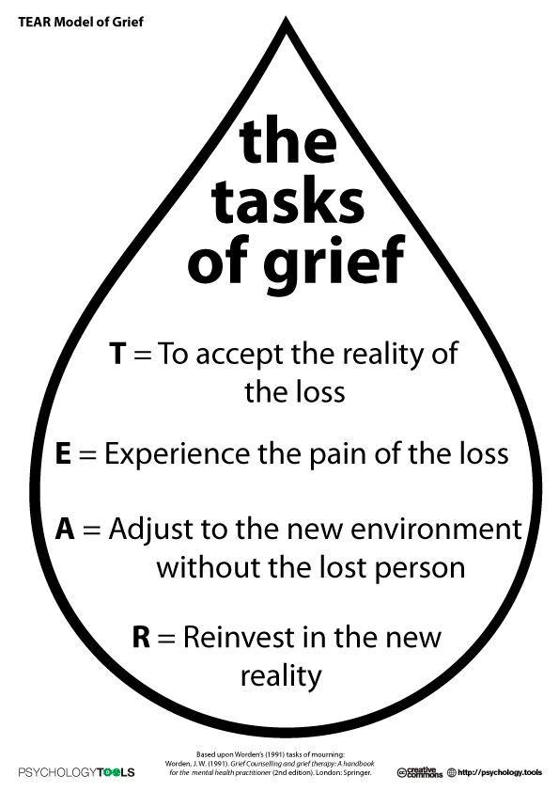

Slide 11
After going blind, the great English poet John Milton wrote the poem "On His Blindness". In the sonnet's last line, he reflects that even with his disability he has a place in the world:
“…They also serve who only stand and wait”
John Milton (1608-74)

Slide 12
This will be an emotional roller coater ride…

Slide 13
… and a marathon, not a sprint

Slide 14
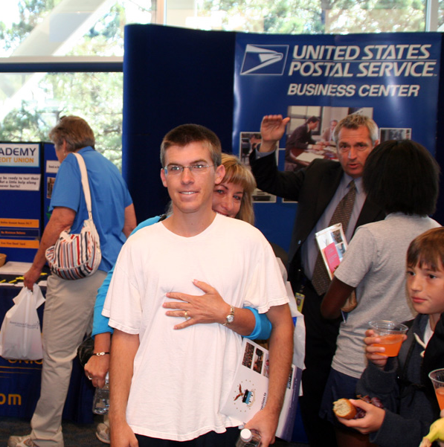
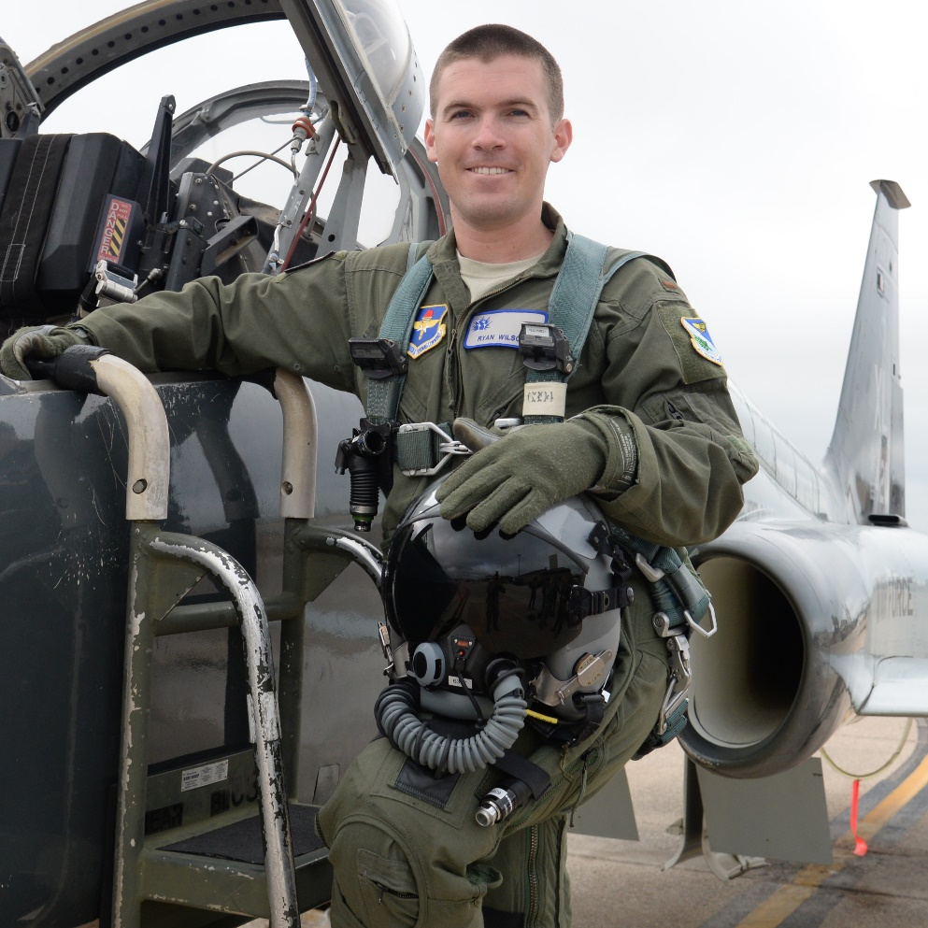

Slide 15
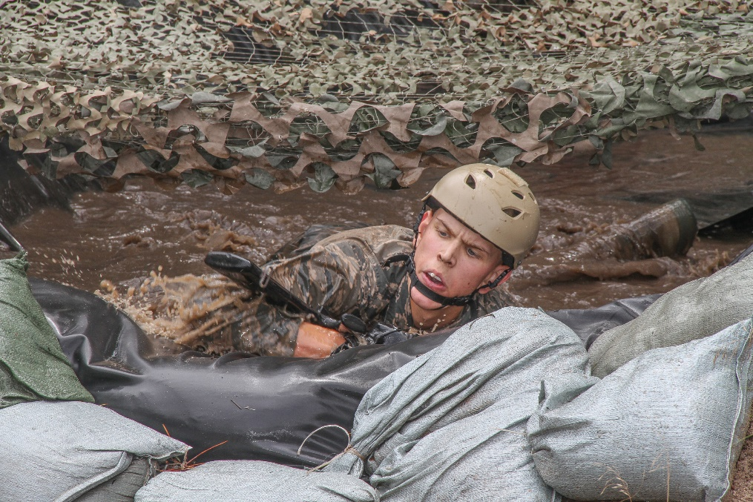
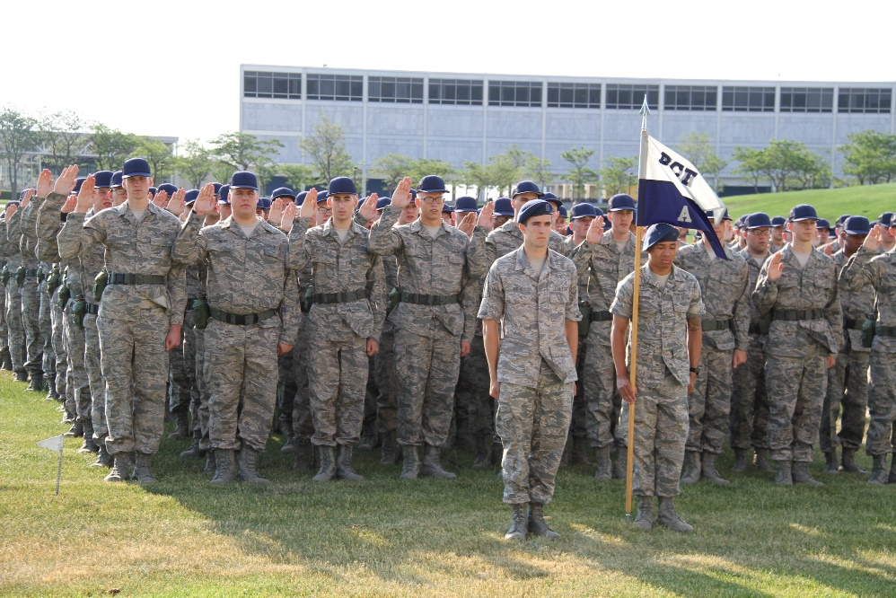
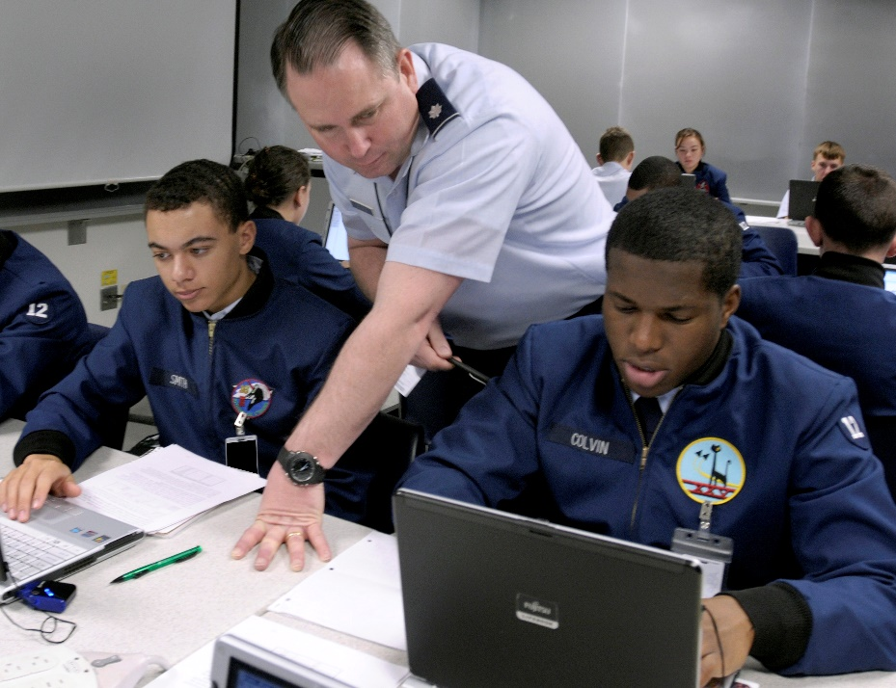

Slide 17
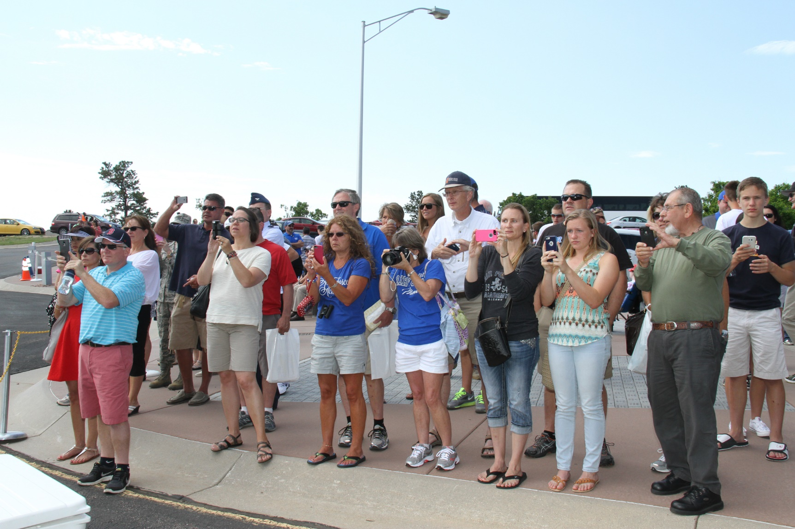
Launching

Slide 18
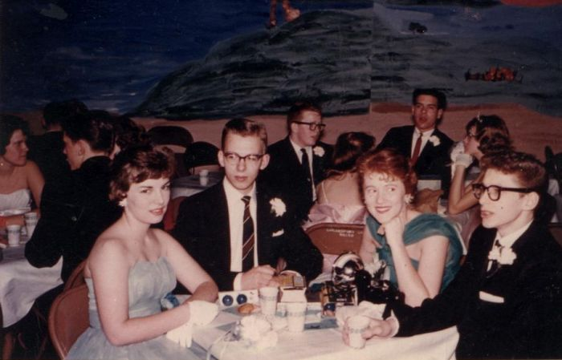
Yesterday’s Candidates

Slide 19
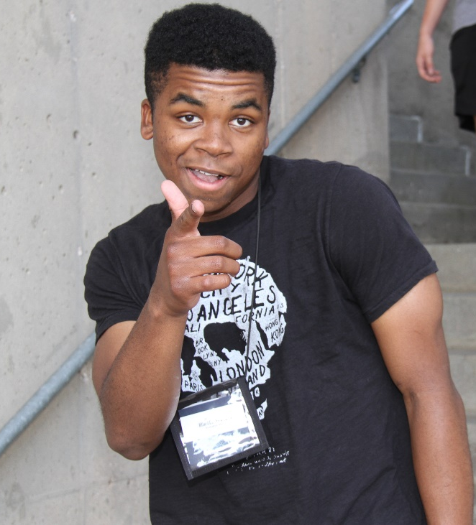
Today’s Candidates
Millenials
Notes:
This slide is a build
Attitudes are different … and looks are too
Is the student with the short hair better than the student with the long hair? We don’t know – you can’t judge by looks

Slide 20
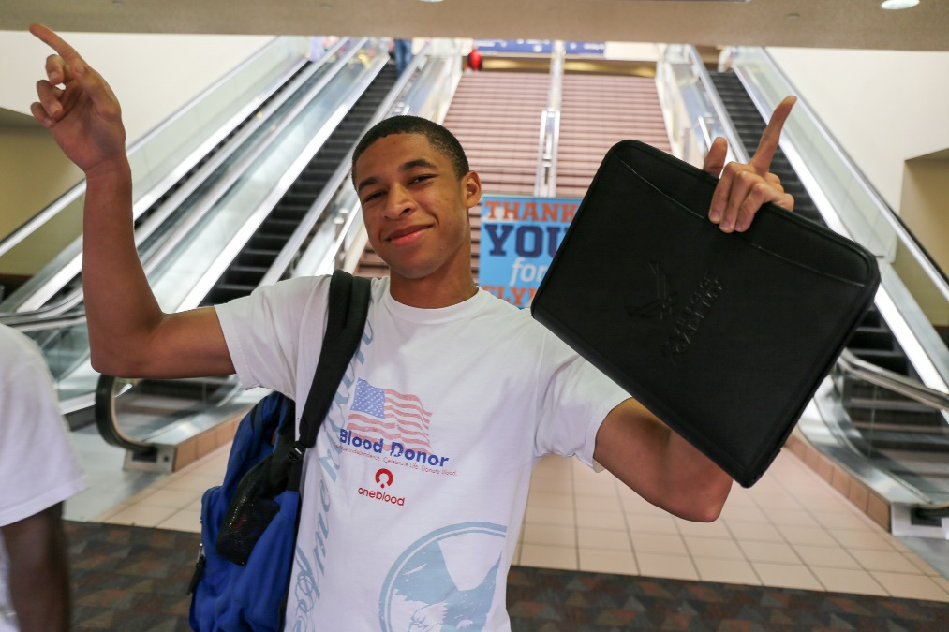
Millennials are on the one hand…
open-minded, connected, team oriented, confident, self-expressive, liberal, upbeat, receptive to new ideas and ways of living, very tech savvy
On the Other Hand…

Slide 21
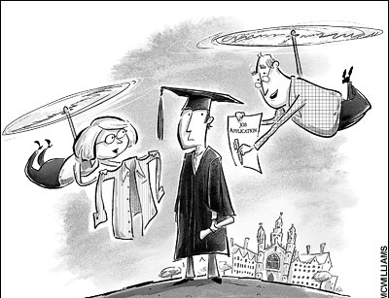
More (Way More) Parental Supervision
Highly protected and scheduled as children. (car seats, baby on board signs, school lockdowns). Parents advocated on their behalf, and “spared” them from unpleasant experiences.
Notes:
“Raised as parent’s friends” – One of my recent candidates volunteered that, “My parents and I put this resume together.” I was surprised on two accounts: 1) his parents helped him, 2) he told me (didn’t think twice about his parents helping him with his resume)
“Parents remind them” – I read an article in the Wall St Journal were a Millennial missed an important deadline at work. When his manager asked him why he missed the deadline, he said, “Why didn’t you remind me?”
- Remember this point as we talk about how much hand holding we should do with our candidates
“Well looked after” – Not only from the entitlement perspective (earlier slide), but also just watched more closely. How many of you heard, “Go outside and play … come back when the street lights come on?” This never happens with kids today. Plus, they all are connected through cell phones

Slide 22
Not Always Well Prepared For Failure or Consequences
Everyone’s a winner …
Sense of entitlement Expectation of frequent positive feedback
Every milestone is marked with celebrations and praise.
Notes:
Red ink hurts self esteem

Slide 23
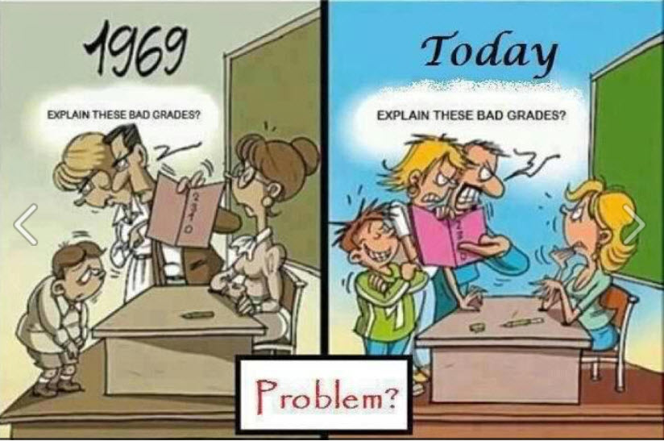
Parents advocated on their behalf, and “spared” them from unpleasant experiences
Sense of entitlement Expectation of frequent positive feedback

Slide 24
Notes:
Red ink hurts self esteem

Slide 25
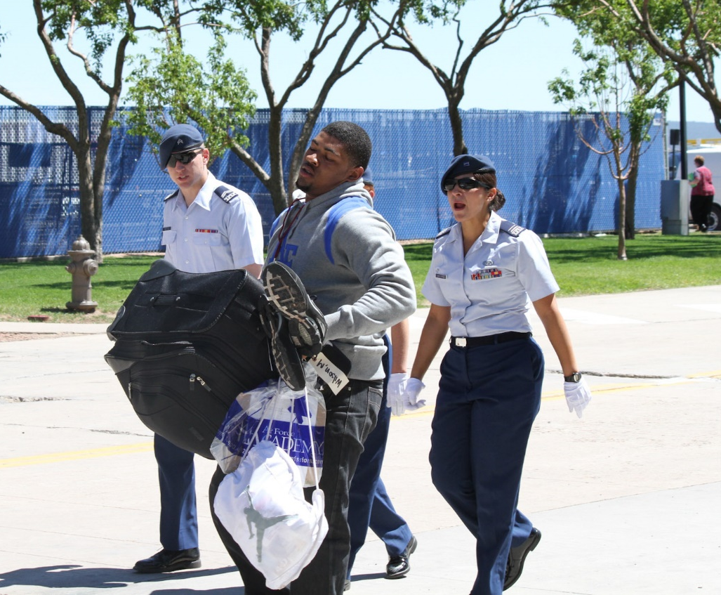
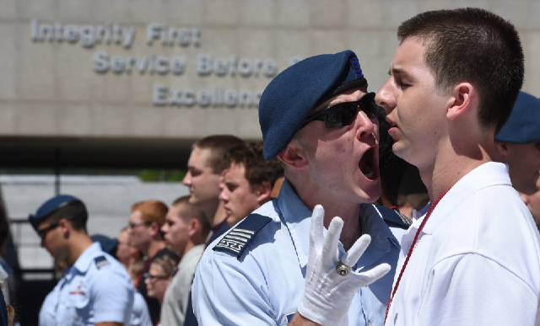
Notes:
Red ink hurts self esteem

Slide 26
<video with narration of Maj Kuda, LtGen Rokke, and a few cadets>

Slide 27
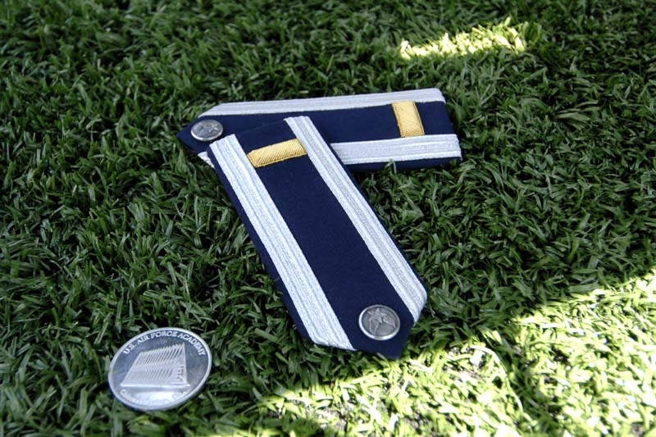
Reasons to Attend USAFA
Service to country as an Air Force officer
Strong academic reputation
Outstanding career possibilities (flying & non-flying)
Unparalleled opportunities for challenging activities & personal development
Because The Student wants to!
(not parents, friends, coaches or relatives)
Notes:
First and foremost among the reasons for attending USAFA is a genuine desire to be part of our nation’s security. Also, the academic reputation of USAFA is recognized nationwide. Another consideration includes guaranteed employment after graduation, maybe as a pilot, and real opportunities for travel, challenge, personal growth, and memories that will last a lifetime. In addition, there are significant Area recreational opportunities (skiing, snowboarding, hiking, etc.) and a wide variety of USAFA Clubs/activities (show choir, D&B, Blue Bards, sports clubs, etc.)
But most importantly, attending the Academy and serving in the Air Force must be what you want to do. Strong personal motivation is absolutely necessary to be successful at the Academy. The top 3 reasons why freshmen (4th classmen) resign are (source - Rollie Stoneman, USAFA admissions):
I don’t want to be an officer
I don’t want the military lifestyle
My parents wanted me to come
add to those:
I came for free school--I didn’t realize how expensive eight years of a certain lifestyle really is
I came for the glamour and prestige and didn’t consider the lifestyle and commitment I would be getting into
Picture: MC-130E/H Combat Talon I/II, www.af.mil/library/factsheets/

Slide 28
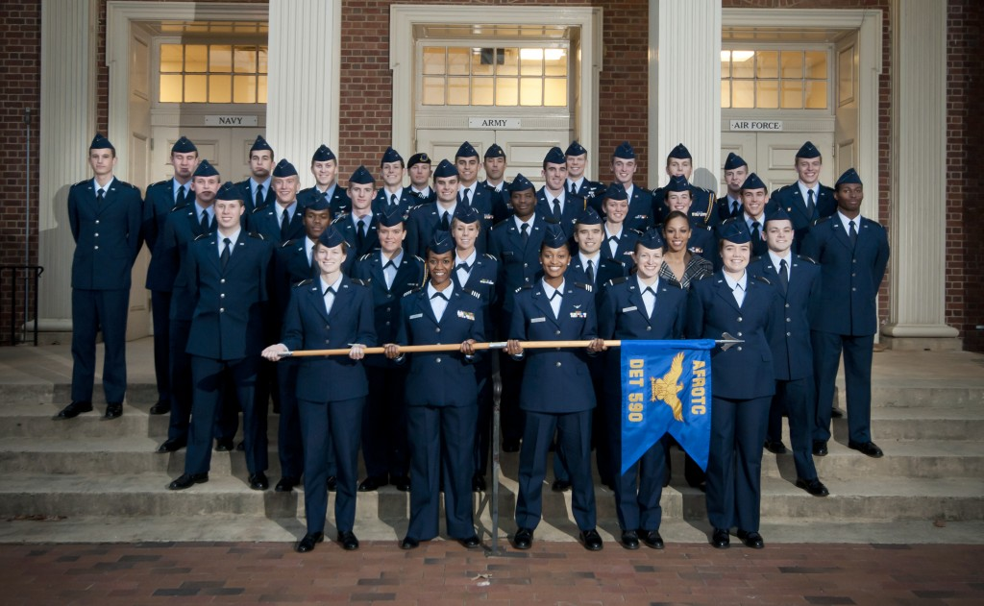
The Service Academy Life Is Not For Everyone

Slide 29
Do’s and Don’ts
Do:
Educate yourself about the admissions & nomination process
Connect now with current service academy parents for support
Recognize this is a time of ambivalence for all parents.
Recognize your child's conflicting emotions.
Be a coach rather than trying to solve your child's problems yourself.
Let them take responsibility for their application and deadlines
Enjoy their senior year in high school – Take lots of pictures

Slide 30
Breathe

Slide 31
Thank You

Slide 32
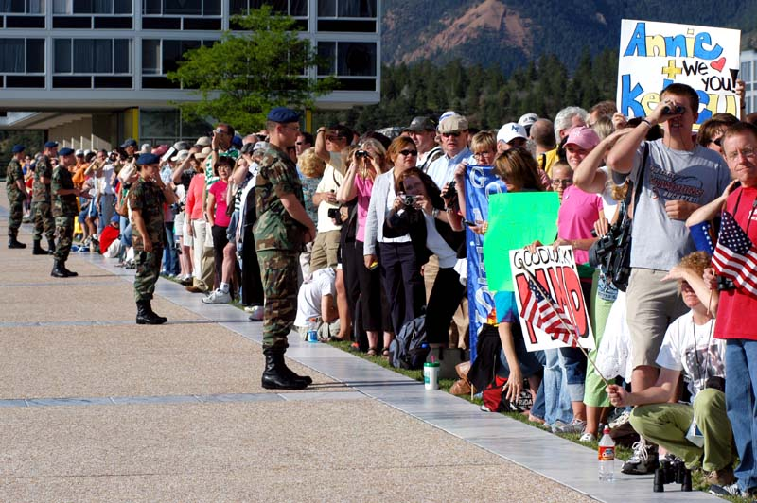
Resources
www.academyadmissions.com admissions.usafa.edu www.usafa.edu www.falconfoundation.org/Fact_Sheet.htm www.goairforcefalcons.com www.usafaparents.org
www.usafaparents.org

Slide 33
Keith Payne
UPALAC President
usafaparents.org

Slide 34
Web Guy
usafawebguy.com
SUPERB resource
Nominal fee
Daily pictures & videos
Support Blogs

Slide 35
Parents Role in the Admissions Process
Questions ?

